Slide 1
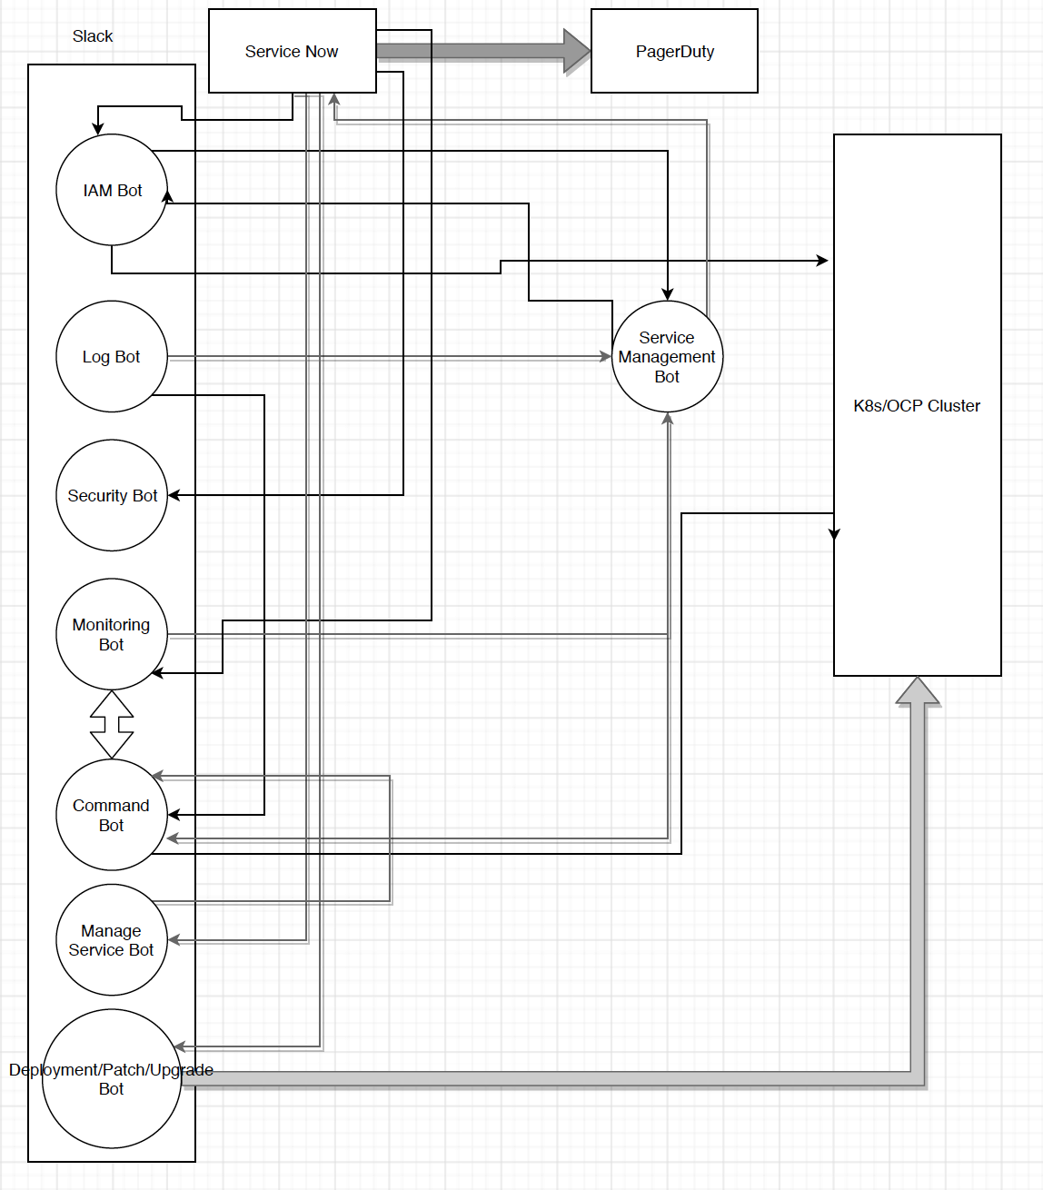
Bots Framework
Slack Bots
Bot
Log Bot
Security Bot
Monitoring Bot
Manage service Bot
IAM Bot
Command Bot
Deployment/Upgrade/Patch Bot

